Slide 1
Modeling tokens on Blockchain (IBM) Midway presentation 234313
Naomie Abecassis
David Valensi
Tutors:
Dany Moshkovich
Artem Barger

Slide 2
Blockchain
A blockchain is a decentralized, distributed chain of blocks that contains information
Each block in the chain contains: data, hash, hash of previous block
Once a block is inserted at the end of the chain, it is immutable, irreversible.

Slide 3
Smart contracts
A self-executing contract with the terms of agreements between buyers and sellers being written directly in code lines.
Trusted transactions and agreements among disparate parties without the need for a central authority.
Contracts are similar to objects in OOP : they contains data in state variables and functions to modify these variables

Slide 4
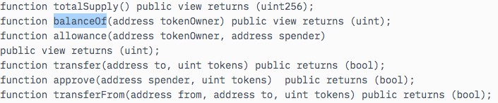
Ethereum plateform and erc20 standard
Ethereum platform is a global blockchain-based platform for decentralized apps.
ERC20 is a popular token standard which defined a common set of functions for Smart Contracts:

Slide 5
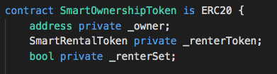
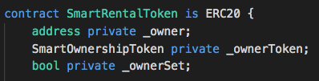
The assets implemented in the project
The 2 assets we implement are Ownership and Rental Tokens.

Slide 6
Object Interactions - Sequence Diagram
SmartOwnershipToken
new OwnershipToken ( )
[owner call] startRent
SmartRentalToken
[actual renter call && rent time interval not elapsed] transfer
alt
[owner ends rental && timeelapsed]
endRentFromOwner
[else if renter ends rental]
[renter call] returnRent ( )
burn ( )
[owner call && !rentset] burn ( )

Slide 7
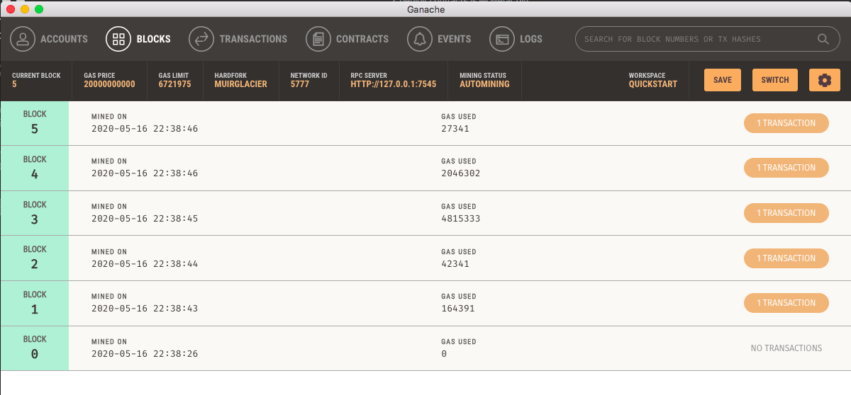
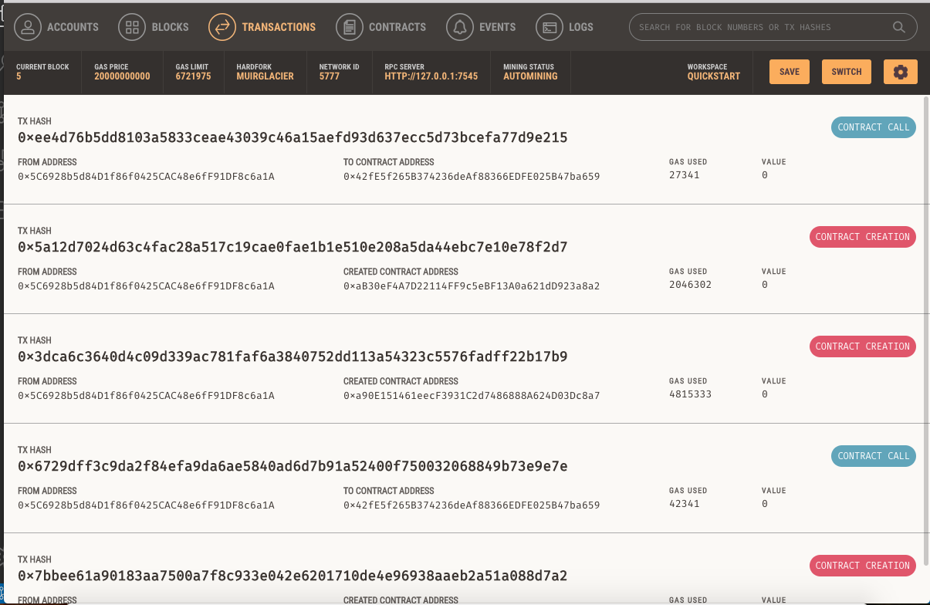
What we’ve done so Far + DEmo
Setup of Ethereum environment : Solidity, Truffle suite, Ganache local testing blockchain
Stand alone implementation of Rental & Ownership token (separately)
Static dependency between Rental & Ownership tokens.

Slide 8
What we’ll do in the Futur
Design of the mechanism for dynamic inter-token dependencies
Summary and limited implementation of dynamic inter-token dependency

Slide 9
Thank you

